Slide 1
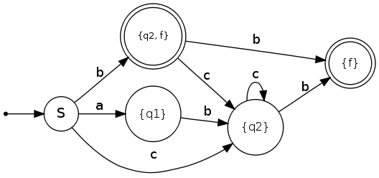
15CSE303-Theory of Computation
Course Overview
Ms.T Bagyammal
Assistant professor (sR.gr)
Department of Computer Science and Engineering,
Amrita School of Engineering, Amrita Vishwa Vidyapeetham, Coimbatore.

Slide 2
Course Objectives & Outcomes
Objectives
Introduce concepts in automata theory and theory of computation
Identify different formal language classes and their relationships
Design grammars and recognizers for different formal languages
Design automata and recognizers for different formal languages
Outcomes
COs | Course Outcome | Bloom’s Taxonomy Level | Course Plan
15CSE303.CO 1 | Understand and apply the properties of formal languages | L3 | Course Plan
15CSE303.CO 2 | Illustrate grammar and grammar transformations for formal languages | L3
15CSE303.CO 3 | Construct finite state machines | L3
15CSE303.CO 4 | Apply stack data structures for automata | L3
15CSE303.CO 5 | Design and develop computing devices such as Turing machines | L4

Slide 3
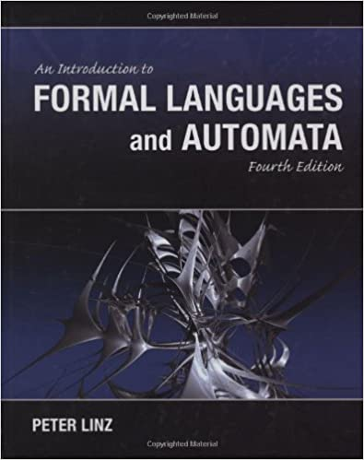
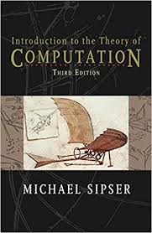
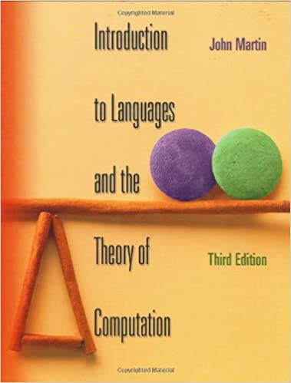
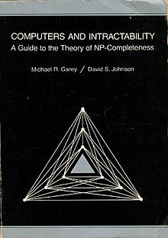
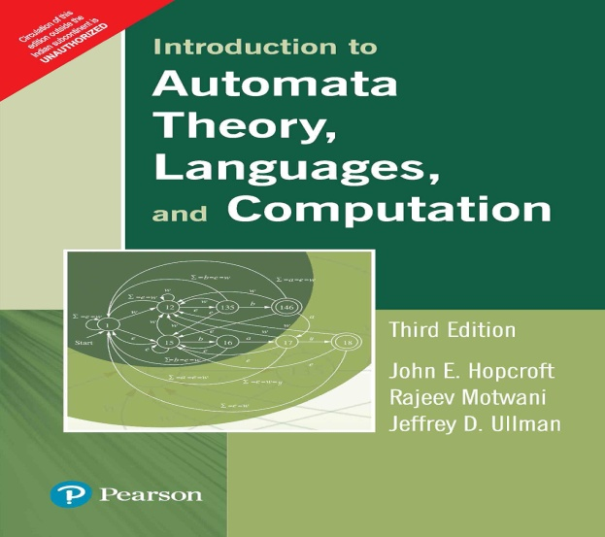
Text / Reference Books
Peter Linz, “An Introduction to Formal Languages and Automata”, Fourth Edition, Narosa Publishing House, 2009 (Text Book)
Michael Sipser, “Introduction to the Theory of Computation”, Third Edition, Cengage Learning, 2012.
John C Martin, “Introduction to Languages and the Theory of Computation”, McGraw Hill, Third Edition, 2002.
Michael R Garey and Johnson D S, “Computers and Intractability: A Guide to the Theory of NP-Completeness”, First Edition, W.H. Freeman and Company, 1979.
J E Hopcroft, R Motwani and J D. Ullman, “Introduction to Automata Theory, Languages, and Computation”, Third Edition, Pearson Education India, 2007.

Slide 4
Course Pre-Requisites & Organization
Pre-Requisites
Data Structure and Algorithms
Discrete Mathematics
Course Organization
Generally, the course will contain three parts:
Part I) Regular languages (21 Hours)
Part II) Context-free languages (15 Hours)
Part III) Context-sensitive languages & Turing machines & decidability. (9 Hours)

Slide 5
Course Assessment Details
S.No | Name of the Assessment | Nos. | Max. Marks | Weightage % | Mode
1 | Quizzes (Internal) | 10 | 20 | 30 | AUMS/AMPLE
2 | Tutorial/Assignment (Internal) | 5 | 20 | 20 | AUMS/AMPLE
3 | Case Study(in Groups) (Internal) | 1 |  | 20 | MS Teams
4 | EndSem-Online Quiz (External) | 1 | 50 | 15 | MS Teams
5 | EndSem-Viva( External) | 1 | 15 | 15 | MS Teams
Total |  |  |  | 100

Slide 6
Faculty Team
S.No | Name of the Faculty | Section | Mail Id
1 | Ms.P.Malathi | A | p_malathy@cb.amrita.edu
2 | Ms.R.Sujee | B | r_sujee@cb.amrita.edu
3 | Ms.T.Bagyammal | C | t_bagyammal@cb.amrita.edu
4 | Dr. M. Senthil Kumar | D | m_Senthil@cb.amrita.edu
5 | Ms. M.Prathilothamai | E | m_prathilothamai@cb.amrita.edu
Mentor: Ms. M. Prathilothamai

Slide 7
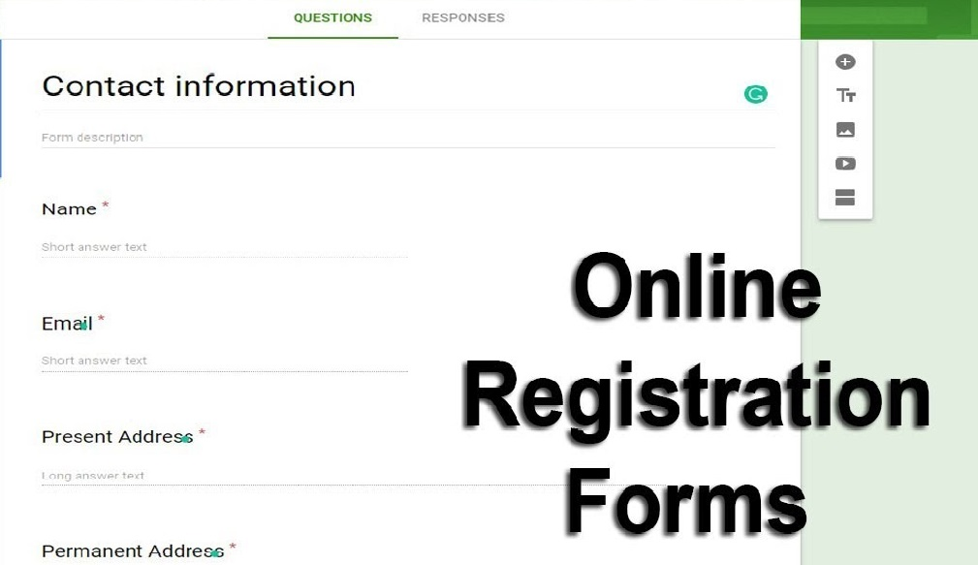
TOC: Practical Applications
Finite Automata (FA)
For the designing of lexical analysis of a compiler.
For recognizing the pattern using regular expressions.
For the designing of the combination and sequential circuits using Mealy and Moore Machines.
Used in text editors.
For the implementation of spell checkers.
Form filling – Pattern matching (e-mail verification)
Unix based system – grep command

Slide 8
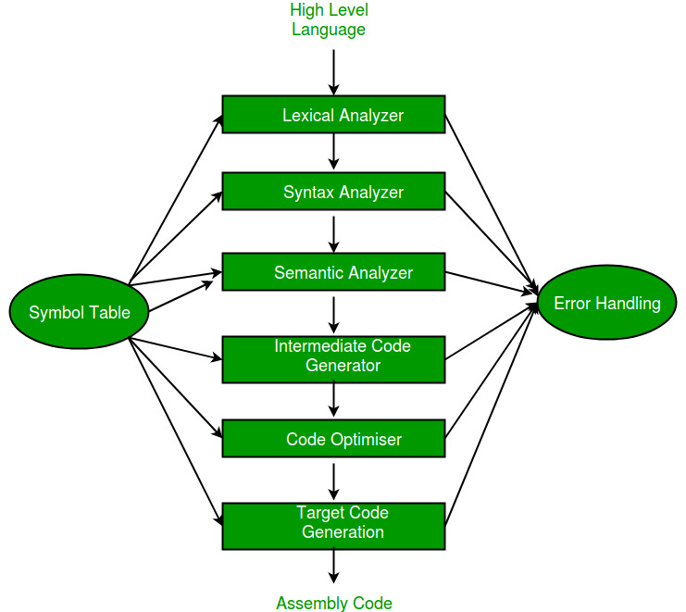
Compiler design Deals with how Compiler converts Higher language program to executable code
After Learning ToC – Next? – Compiler design
Phases of a Compiler
Finite Automata(Regular grammar)
Push down Automata(Context free grammar)
Linear bounded Automata(Context sensitive grammar)

Slide 9
Phase 1: Lexical Analysis
The primary functions of this phase are:
Identify the lexical units in a source code
Classify lexical units into classes like constants, reserved words, and enter them in different tables. It will Ignore comments in the source program
Identify token which is not a part of the language
Example:
x = y + 10
Tokens
LEXICAL UNIT | CLASS
X | identifier
= | Assignment operator
Y | identifier
+ | Addition operator
10 | Number

Slide 10
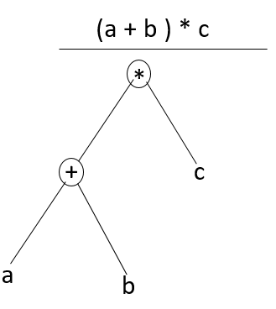
Phase 2: Syntax Analysis
List of tasks performed in this phase:
Obtain tokens from the lexical analyzer
Checks if the expression is syntactically correct or not
Report all syntax errors
Construct a hierarchical structure which is known as a parse tree
Parse tree for the following example : (a+b)*c

Slide 11
Phase 3: Semantic Analysis
Functions of Semantic analyses phase are:
Helps you to store type information gathered and save it in symbol table or syntax tree
Allows you to perform type checking
In the case of type mismatch, where there are no exact type correction rules which satisfy the desired operation a semantic error is shown
Collects type information and checks for type compatibility
Checks if the source language permits the operands or not
Example
float x = 20.2;
float y = x*30;
In the above code, the semantic analyzer will typecast the integer 30 to float 30.0 before multiplication

Slide 12
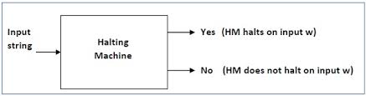
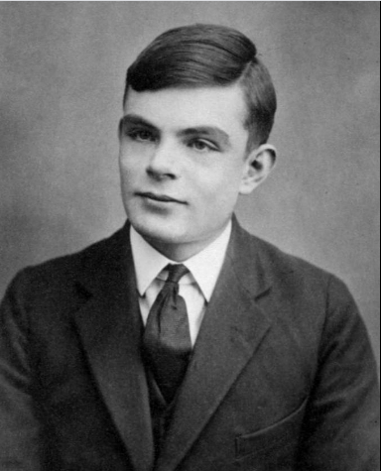
Halting problem (Turing Machine)
ALAN TURING
mathematician, computerscientist, logician,
cryptanalyst, philosopher, and theoretical biologist.
Known for
Cryptanalysis of the Enigma
(During the Second World War)
Turing's proof
Turing machine
Turing test
Unorganised machine
Turing pattern
Turing reduction
The Chemical Basis of Morphogenesis

Slide 13
Why Theory of Computation (TOC) is Important?
Automata /Machine/Mathematical model
To understand the nature of efficient computation.
In theoretical Computer Science and Mathematics, the TOC is the branch that deals with how efficiently problems can be solved on a model of computation, using an algorithm.
To understand and design a Compiler in better manner.
Student will be able to answer all questions of important exams like GATE, ISRO, DRDO etc.

Slide 14
TOC: Practical Applications
Circuit Design and Verification
Finite Automata
Natural Language Processing
Linguistics (Modelling by grammar)
Game Development
Finite Automata as strategy models in decision making

Slide 15
TOC: Practical Applications
Finite Automata (FA)
For the designing of lexical analysis of a compiler.
For recognizing the pattern using regular expressions.
For the designing of the combination and sequential circuits using Mealy and Moore Machines.
Used in text editors.
For the implementation of spell checkers.
Form filling – Pattern matching (e-mail verification)
Unix based system – grep command

Slide 16
TOC: Practical Applications
Push Down Automata (PDA)
For designing the parsing phase of a compiler (Syntax Analysis).
For implementation of stack applications.
Evaluating the arithmetic expressions.
Solving the Tower of Hanoi Problem.

Slide 17
TOC: Practical Applications
Linear Bounded Automata (LBA)
For implementation of genetic programming.
For constructing syntactic parse trees for semantic analysis of the compiler.
Turing Machine (TM)
For solving any recursively enumerable problem.
For understanding complexity theory.

Slide 18
Interesting Applications & Tools
Interesting Applications
Finite State Machines – Traffic Light Simulation
https://youtu.be/jLLAtxPNaC0
Finite State Machines in Embedded Programming
https://youtu.be/0Fqa5RFZ29E
Finite State Machines in games: AI
https://youtu.be/ayssrKvqJ4g
Deep Turing Machine(DTM)
The AI of Half-Life: Finite State Machines
https://youtu.be/JyF0oyarz4U

